Slide 1




Deniz Katayıfçı 2020510053
Eren Çiçek 2020510082
Yasir Uslu 2021510067
Baturalp Erdem Yasa 2021510092

Slide 2

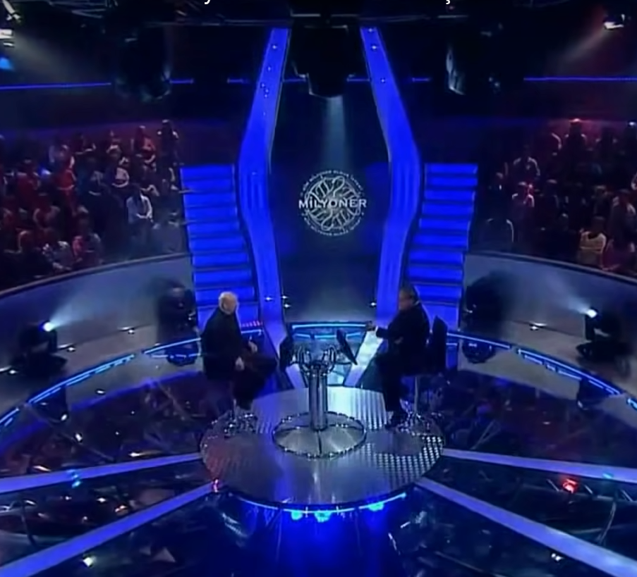
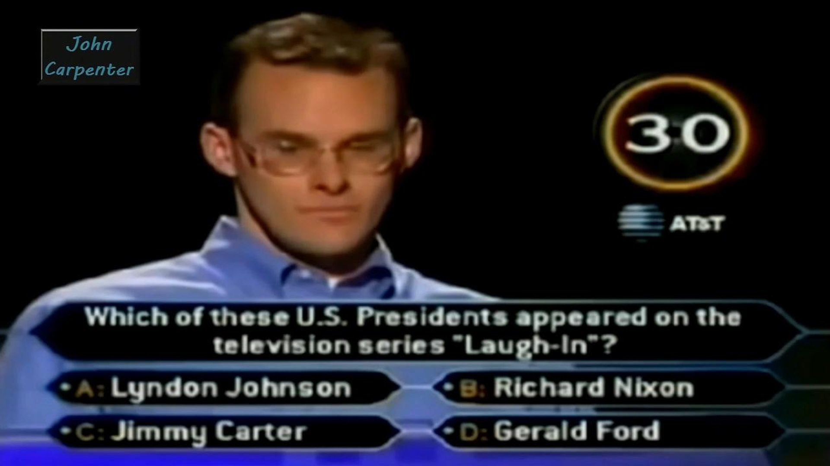
Outline
ıntroductıon
PROGRESS SUMMARY
Requirements
Task Sharing
Scheduling
Completed Tasks
Incomplete Tasks: Reasons, Explanations
Additional Improvements
PROBLEMS ENCOUNTERED
ALGORITHMS AND SOLUTION STRATEGIES
SCREENSHOTS
conclusıon
REFERENCES

Slide 3

Introduction
The aim of the project is to develop a software application for the "Who Wants to Be a Millionaire" competition.
Contestants’ aim is winning the $1,000,000 prize with questions of 5 different difficulty levels.
Contestants have 20 seconds per question, double dip and 50% lifelines.

Slide 4
REQUIREMENTS
TEAM-WORK
CLASSES
FUNCTION STRUCTURE IN JAVA
NECESSARY WEB RESOURCE SCANNING
ALGORITHMIC THINKING ABILITY

Slide 5
TASK SHARING
DESIGNING THE SCREEN
SPELL CHECK
CREATION OF WORD CLOUD
DESIGNING CLASSES
COMPETITION
LIFELINES
STATISTICS
TIMER CONTROLS

Slide 6
COMPLETED TASKS
Necessary class structures
Spellcheck
Wordcloud
Displaying the questions and the table(money,time…)
Creating the timer
Statistics class
Adding the sound effects

Slide 7

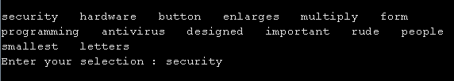
Scheduling
WEEK 1 = On first week; reading files, spell check function and creation of word cloud are completed.

Slide 8
Scheduling
WEEK 2 = Necessary classes and methods have been created for questions and participants
WEEK 3 = Printing questions, answer checks, lifelines have been completed.
WEEK 4 = Necessary structures for statistics and timer were created, some bugs were fixed and improvements were made to the code. Also added sound effects.

Slide 9
PROBLEMS ENCOUNTERED
Splitting birthday dates in java.
Problems while writing the table (Money,time…)
Some formatting issues while reading files.

Slide 10
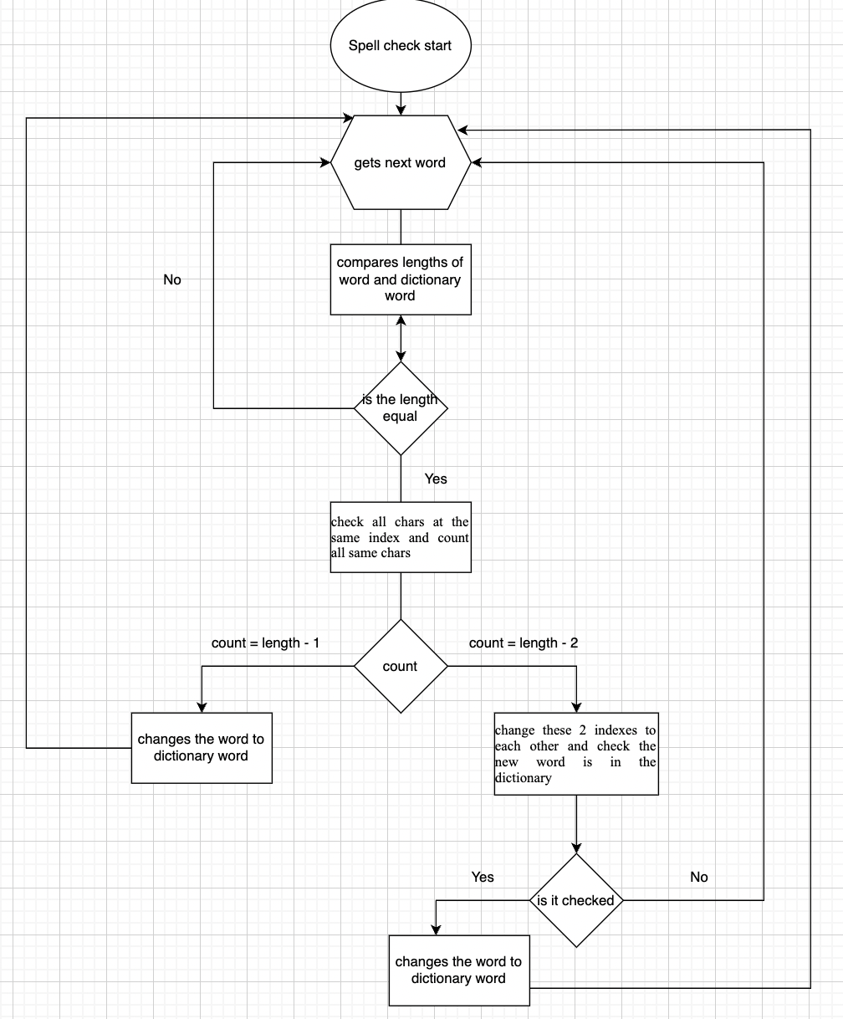
ALGORITHMS AND SOLUTION STRATEGIES
Spellcheck
This method compare words with given dictionary and corrects them.

Slide 11
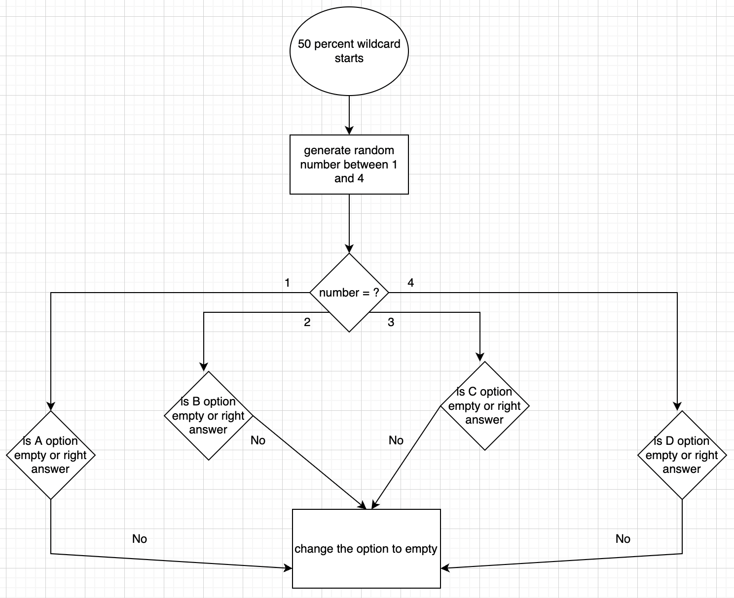
ALGORITHMS AND SOLUTION STRATEGIES
50percent wildcard
This method randomly deletes two of the wrong choices.

Slide 12
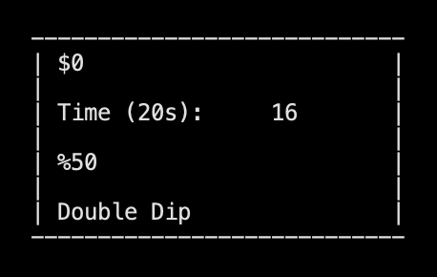
ALGORITHMS AND SOLUTION STRATEGIES
Timer
Timer is a basicaly a timer which is counting to 20 seconds.
After 20 seconds if there is no input by the user then it’s says your time has up.
It’s also has a lifelines in the table.

Slide 13
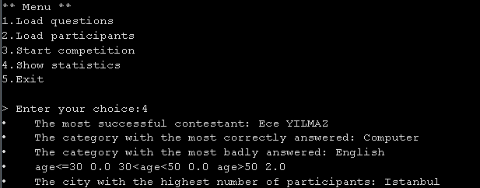
ALGORITHMS AND SOLUTION STRATEGIES
Statistics
The most successful contestant
The category with the most correctly answered
The category with the most badly answered
On average, how many questions did contestants in each age group answer correctly?
Age<=30, 30<Age<= 50, Age>50
The city with the highest number of participants

Slide 14
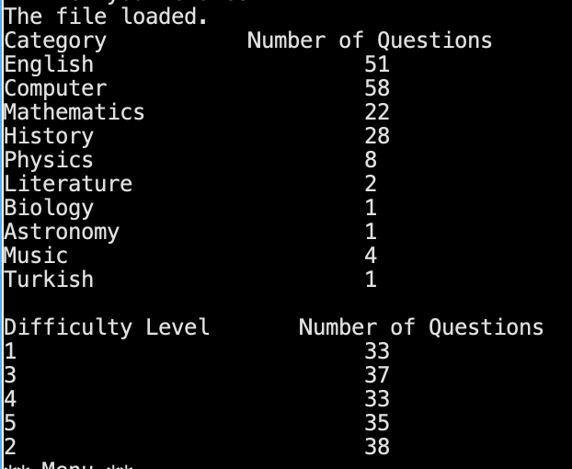
Screenshots

Slide 15
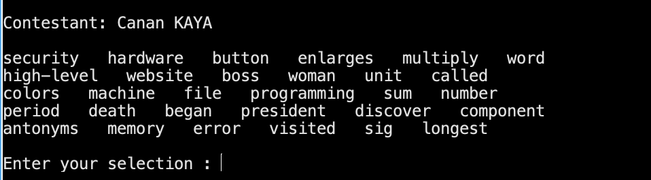
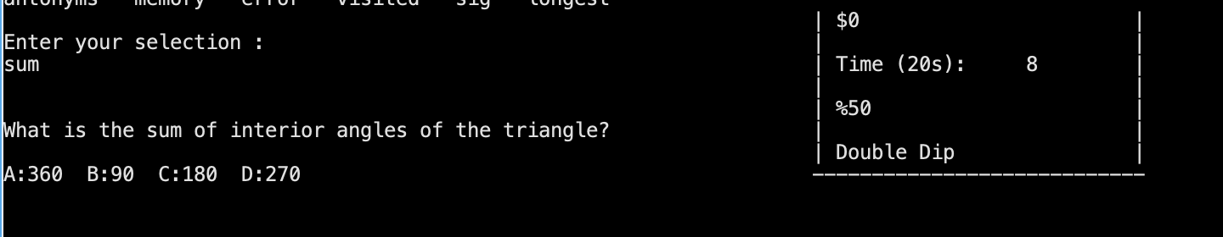
Screenshots

Slide 16
Conclusion
We have transferred our algorithm information to the project for 4 weeks
The goals of the project were completed successfully.

Slide 17
REFERENCES
https://www.baeldung.com/java-string-split-by-newline
https://www.tutorialkart.com/java/java-util-arrays-aslist/
https://www.java67.com/2016/10/10-reasons-of-javalangnumberformatexception-in-java-solution.html
https://www.codegrepper.com/code-examples/java/keep+only+2+digits+after+decimal+in+java

Slide 18
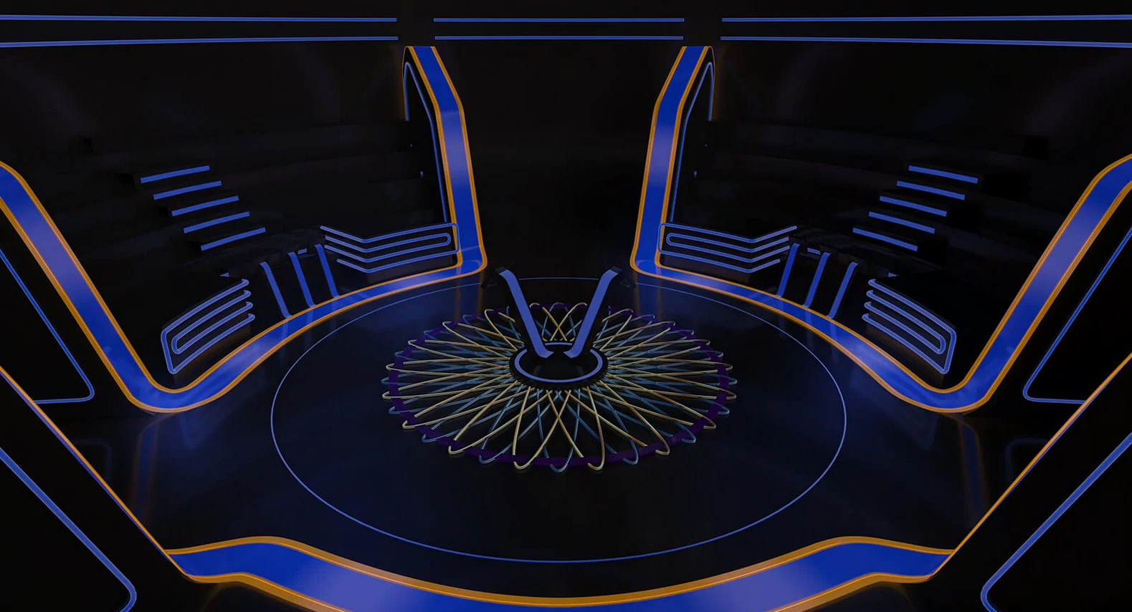
Thank you for listening us.
Any Questions ?

